Slide 1
Why openSUSE 12.3?
Efstathios Iosifidis
openSUSE member, ambassador
iosifidis@opensuse.org

Slide 2
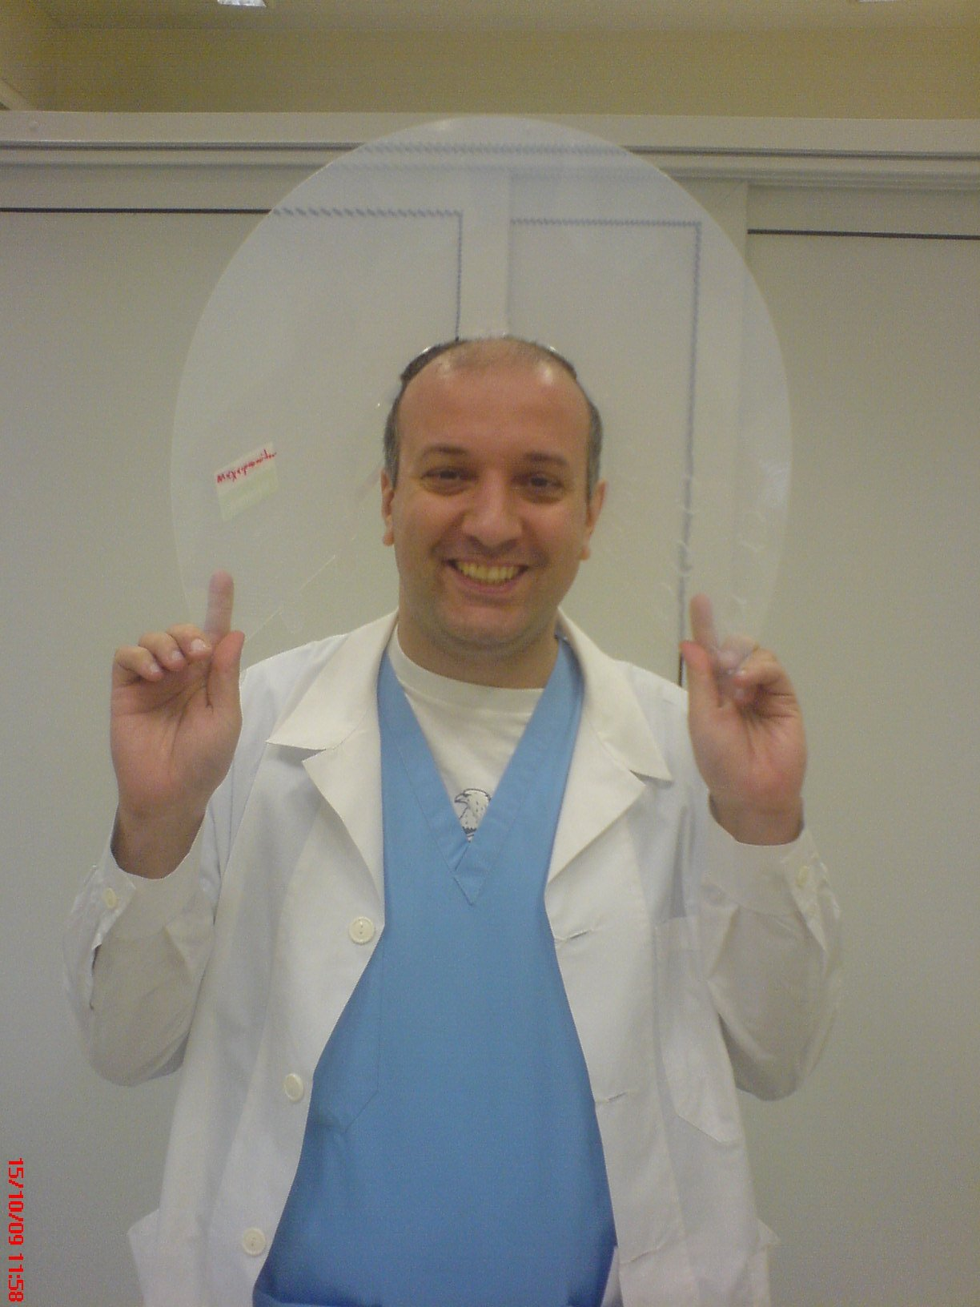
Me
Efstathios Iosifidis
openSUSE member, ambassador
iosifidis@opensuse.org
Notes:
SLED 11 was released in March 2009, a few months after openSUSE 11.1

Slide 3
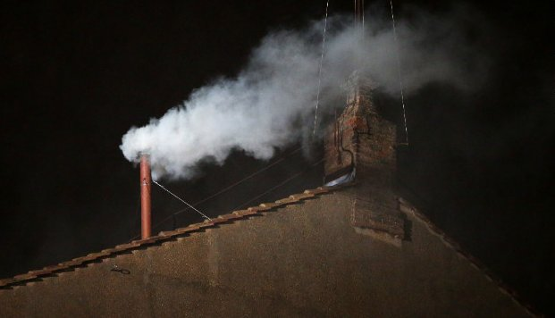
Everyone expected!!!

Slide 4
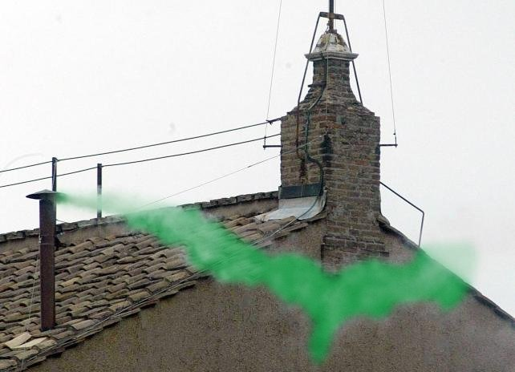
What happened... openSUSE 12.3

Slide 5
Why does openSUSE matter?
Compilation of the 'latest and greatest' stable software available from the F/LOSS community
The Linux distribution for “Power Users” who want to get work done
  Capable as a Desktop, Server, Embedded (ARM), etc..
Upstream for SUSE Linux Enterprise
  SUSE Linux Enterprise 12 expected 2014
Notes:
SLED 11 was released in March 2009, a few months after openSUSE 11.1

Slide 6

GNOME 3.6
Design driven. Clean, simple to use, but still powerful
  “Mac-like”
  Smarter notifications including a redesigned Message Tray
Integrated applications
  Documents – Browse/Search local, network and 'cloud' documents
  Disks – Powerful user tool for Disk/Removable media management
  Empathy – Integrated messaging - “Distraction Free computing”
  Files – Search that works, and improved workflows
  Boxes – KVM Desktop virtualisation – Bye Bye Virtualbox!
'Online Accounts' integration
  Google, Facebook Windows Live, Active Directory authentication/integration

Slide 7
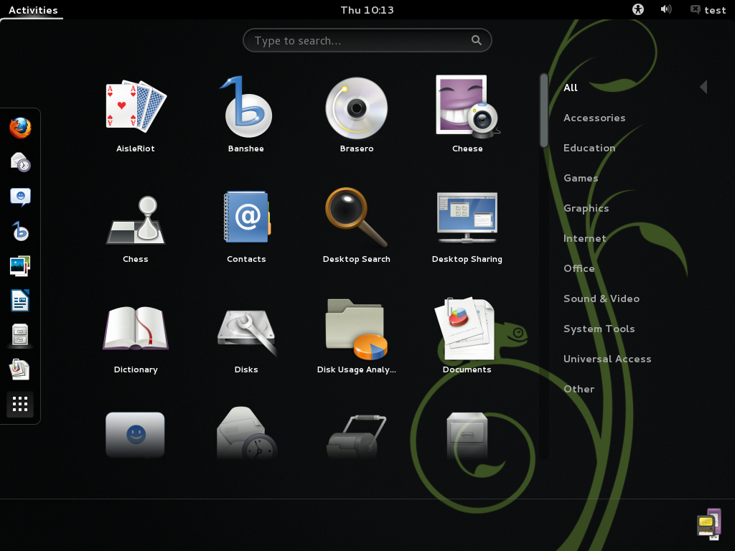

Slide 8

KDE 4.10
Feature driven. Highly customisable desktop environment
Showcase for the capabilities of Qt
Window Management improvements
  Scripting support to add functionality/effects to Kwin
  openGL support in most Vms
  Per-monitor colour management
Menu customisations – replace Application menu with Title bar button
File Manager performance improvements
New Print Manager – support for latest CUPS
Nepomuk cleaner – tidy up metadata storage
The Apper update manager v 0.8 should no longer create blocking issues with the zypper commandline and GUI package managers.

Slide 9
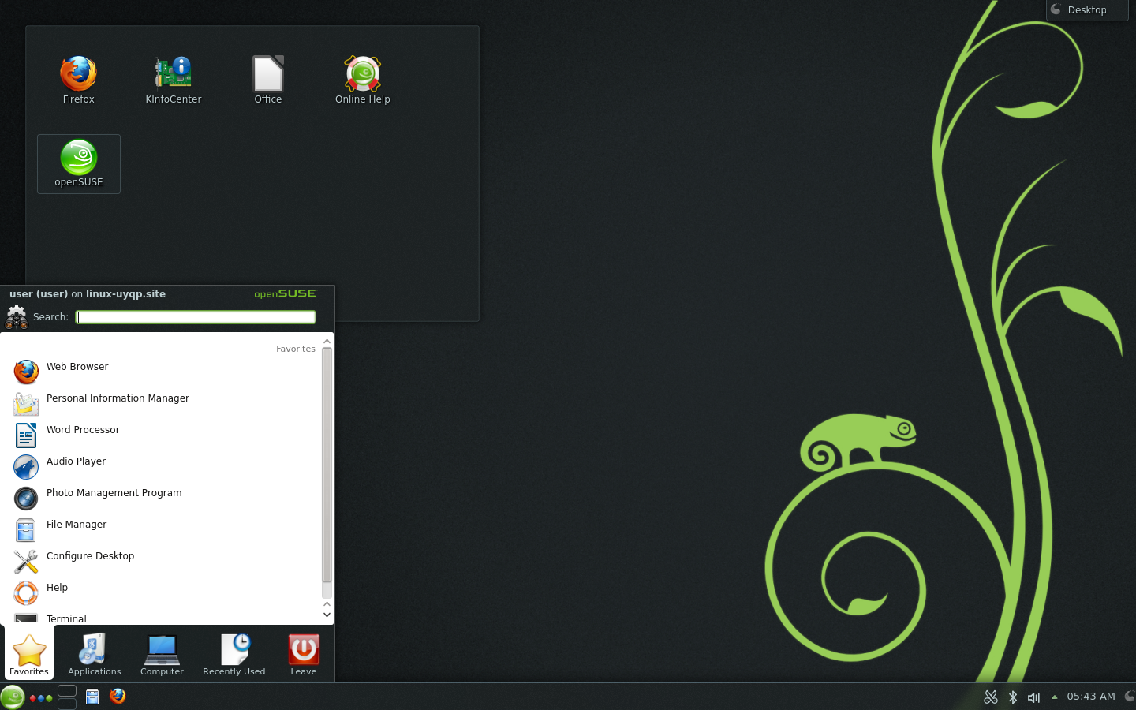
KDE 4.10 – Plasma Desktop

Slide 10



Other Window Managers
XFCE
Tabbed Thunar file manager
quake-style drop-down mode in xfce4-terminal
Sawfish (window manager using a Lisp-based scripting language)
awesome (highly configurable, next generation framework window manager for X)
LXDE 1.1
Enlightenment 17 (E17): Version 0.17.1
Notes:
Xfce, awesome, Sawfish, Enlightenment 17
Other desktop improvements include an updated Xfce which brings a tabbed Thunar file manager with improved bookmark handling and extensive performance improvements and a quake-style drop-down mode in xfce4-terminal (0.6.0) which keeps a running terminal around that can be quickly accessed through a keyboard shortcut. New in openSUSE 12.3 is Sawfish, an extensible window manager using a Lisp-based scripting language. And new is awesome too, a highly configurable, next generation framework window manager for X. It is very fast and extensible and primarily targeted at power users and developers. Enlightenment 17, also known simply as E17, is a stacking window manager for the X Window System which can be used alone or in conjunction with a desktop environment such as GNOME or KDE.

Slide 11
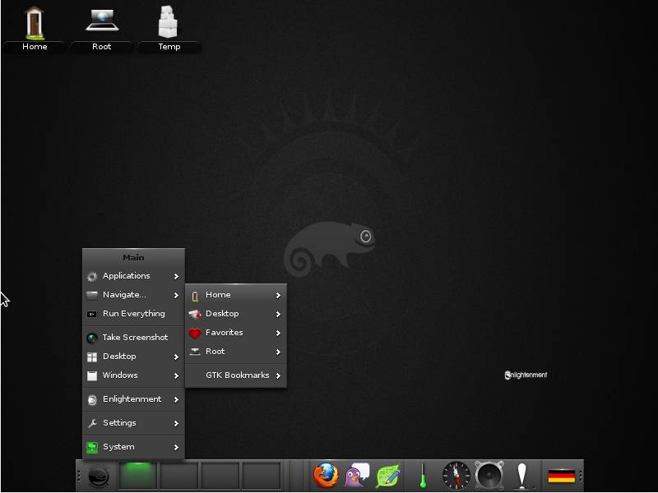

Slide 12
Server Developments – Databases
MariaDB replaces MySQL as default database server
  More storage engines (XtraDB – fork of InnoDB)
  Lots of performance & feature improvements over MySQL
  Tested with 200,000+ connections
  Optional drop-in replacement for upgrades
  MySQL still included in openSUSE
PostgreSQL 9.2
  Native JSON support – use PostgreSQL like a 'NoSQL' document database
  Improved scalability & performance (2-20x faster)

Slide 13
Server Developments – Other Highlights
BIND 9.9
  Inline signing – Simplified deployment of DNSSEC
Tomcat 7
  Servlet 3.0, JSP 2.2, EL 2.2
Squid 3.2.6
  Client Bandwidth Limits, IPv6, SMP scalability, better streaming support
WebYaST
  “Finally works” on openSUSE 12.3
Nagios 3.4.4
  Bugfixs/security - simplified Install
Notes:
Nagios automatically makes user/groups needed

Slide 14
Virtualisation – Highlights
KVM
  SPICE, qxl & USB3 support, USB redirection supports live migration
Xen 4.2.1
  'xl' replaces 'xm/xend' tools – SPICE support, but no qxl or USB pass-through
  EFI support
  Scalability/density improvements
    Support for 4095 CPUs and upto 5TB RAM on 64-bit hosts
    Upto 512 VCPUs per Paravirtualised VM, 256 VCPUs per 'Fully Virtualised' VM
LXC 0.8.0
  Apparmor support
  Container 'imaging' with lxc-clone – supports LVM2 and btrfs snapshots
  yast2-lxc – simple management of LXC Containers
Notes:
SPICE – multiple data channel, VNC replacement
Qxl is a componant of spice, virtualised GPU used with spice to get accelerated/smooth remote desktop

Slide 15
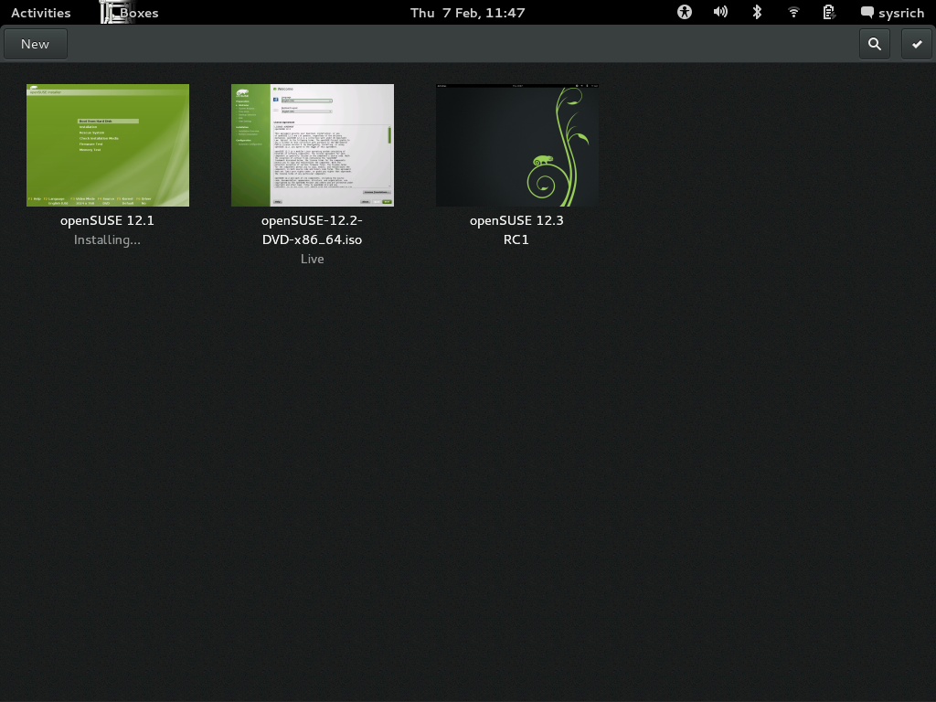

Slide 16
Cloud - OpenStack
First release of openSUSE with complete packages for OpenStack
DevStack – developer tools/scripts to quickly build simple OpenStack test/dev environments
Improved Web Dashboard
Image replication
New API and client tool for image service
Return of Hyper-V support
Public-Key authentication
Notes:
The Stuff behind SUSECloud

Slide 17
What's new for developers?
IDEs and tooling
Anjuta 3.6 with git integration improvements.
QtCreator 2.6 with ‘Kits’ offering settings for which device type to develop for.
KDevelop 4.4 introduces a new welcome screen which helps you to get started with a project in an intuitive way.
Fossil Distributed Version Control System offers wiki, bugzilla and blog functionality)
Languages and Libraries
Mono 3 supports the new async C# 5.0.
Python 2.7.3 remains the default, Python 3.3.0 is now available
Python-qt4 supports Qt 5 now.
The KDE Development Platform introduces a more comprehensive SDK for Plasma and GTK 3.6
openSUSE Tools
KIWI 5.04.37 (arm based boards)
Open Build Service

Slide 18
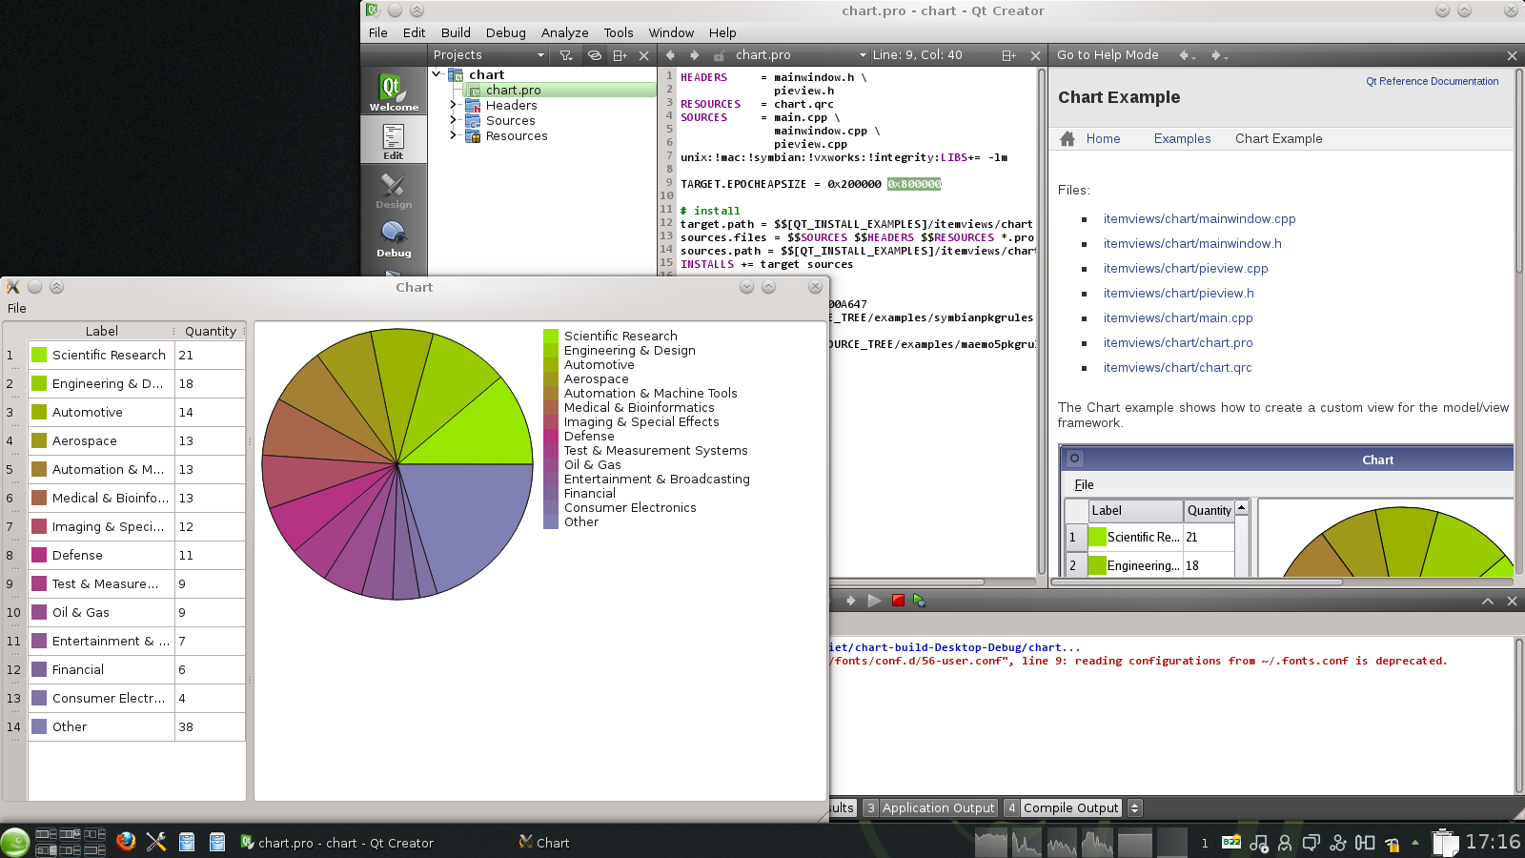

Slide 19


Slide 20
Kernel 3.7 which is well tested
A few highlights:
Raid 10 support for the device mapper
Aggressive SATA device sleep for SSD and HD power saving and (opportunistic) suspend in the kernel and system tools.
btrfs snapshot diffs, disable copy-on-write on a per-file base and snapper 0.1.1 for snapshots by users and LVM thin-provisioned snapshots
Performance profiling with perf trace
Higher TCP performance (Fast Open/Early Retransmit/Small Queues) and more resistance to the dreaded ‘buffer bloat’
SMBv2 protocol support as well as stable NFS 4.1
Improved security with support for signed kernel modules, stronger sandboxing for sshd and more
faster and more stable Nouveau NVidia driver, supporting newer hardware
zypper ar http://download.opensuse.org/repositories/Kernel:/stable/standard Kernel:stable
zypper in --from Kernel:stable kernel-desktop

Slide 21
systemd – Timeline
Previewed in openSUSE 11.4
Default in openSUSE 12.1
sysVinit removed in openSUSE 12.3

Slide 22
systemd – what you need to know
sysVinit had Runlevels, Numbered 0-5
  0 – shutdown
  1 – single user mode
  3 – multiuser with network
  5 – multiuser with network and X
Systemd has “target units”
  halt.target (aliases – runlevel0.target, poweroff.target)
  rescue.target (aliases – runlevel1.target)
  multi-user.target (aliases – runlevel3.target)
  graphical.target (aliases – runlevel5.target)

Slide 23
systemd – what you need to know
Changing targets
  init <runlevel number> - still works, but deprecated
Instead
  systemctl isolate <my_target>.target
    eg. systemctl isolate multi-user.target

Slide 24
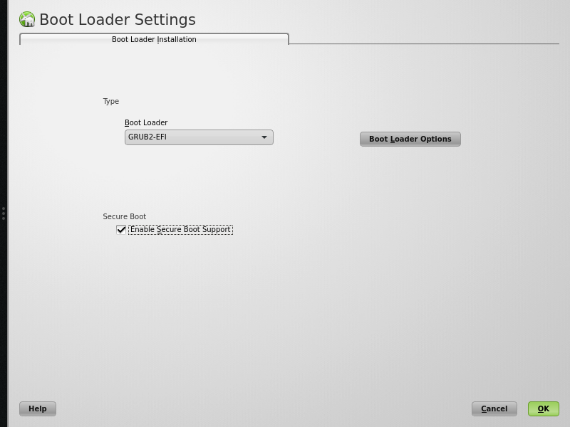
Secure boot - UEFI
This release delivers proper UEFI support for x86_64 hardware and experimental support for Secure Boot enabled hardware.
Details: https://en.opensuse.org/openSUSE:UEFI

Slide 25

Tumbleweed
Notes:
The first openSUSE project: Tumbleweed
Tumbleweed is a project started by Kernel Hacker Greg Kroah-Hartman.
He is also contributing to Gentoo and as you might know, Gentoo is a Rolling distribution: there are no special releases. When something is done, it becomes available. And because it is Gentoo, you then Compile it :D

Slide 26

Rolling Release? No problem!!! Tumbleweed
Normal: 2 life cycles + 2 months = 18 months.
Tumbleweed: Solved the problem of rolling updates version.
Always the latest stable software
  Latest kernel = latest hardware support
  Latest browser, office, desktop, games...
  No more 'download and install the new release'!
Details: http://en.opensuse.org/Portal:Tumbleweed

Slide 27
LTS? No problem!!! Evergreen
Normal: 2 life cycles + 2 months = 18 months.
"Evergreen" is a community effort to prolong maintenance of selected openSUSE versions as they reach official end-of-life
11.2: Support started May 12th 2011, support ends Nov 2013
Total: July 15, 2010 – Nov 2013
11.4: Support started Nov 5th 2012, support ends July 2014
Total: March 10th 2011 - July 2014
Details: https://en.opensuse.org/openSUSE:Evergreen

Slide 28
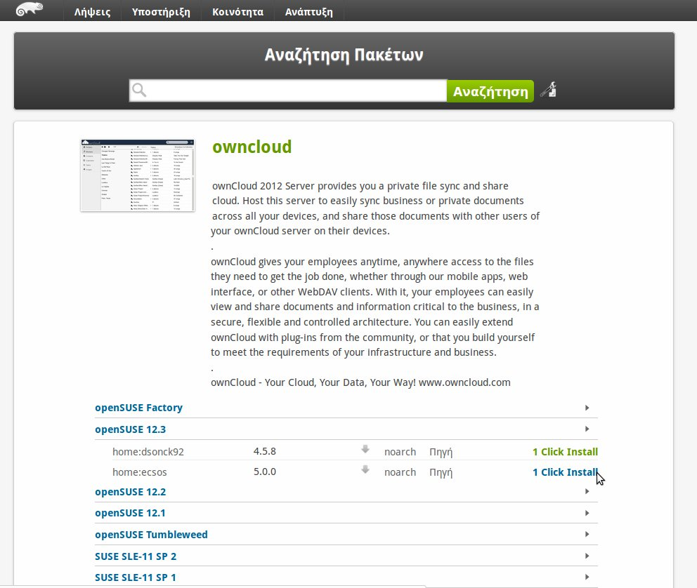
1-click-install
http://software.opensuse.org/

Slide 29

OBS...
Free
on
build.opensuse.org
200.000
users
packages
40.000
26
7
distributions
OpenSUSE ARMs
architectures
Notes:
The Open Build Service is a tool to build packages for ANY linux distribution (or even Windows if you want). It uses a Virtual Machine to cleanly build, has dependency tracking, team collaboration features and is completely useable through an easy to use Web Interface.
If you want to build packages for Fedora, Ubuntu, Mandriva, openSUSE and more – check it out on build.o.o
Of course it is Free Software and you can run your own instance, like Tizen/MeeGo/Mer, VLC, Dell and many others do.

Slide 30
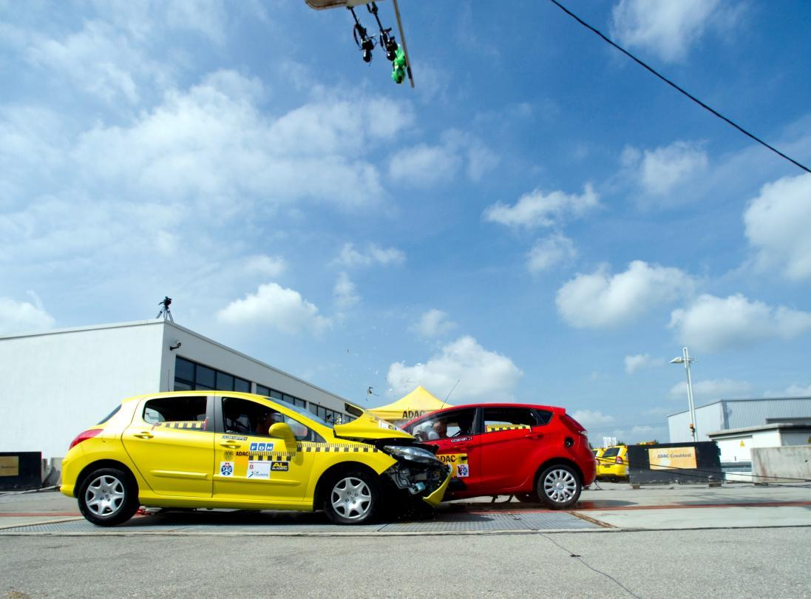
openQA
Notes:
The next project I want to talk about is openQA

Slide 31

openQA
Fully automated testing
  Used to daily test openSUSE Factory
Easy web interface showing results as images and video
Covers:
  Installation and upgrade testing
  Daily regression testing
  Application testing
  benchmarking
Free and cross-platform Software
  Run your own tests on your own system!
  openqa.opensuse.org

Slide 32
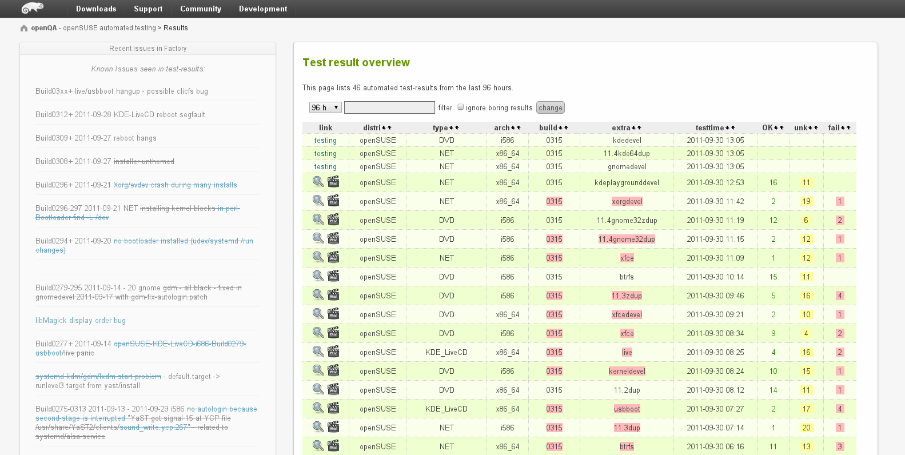
Overview of all tests ran on openSUSE Factory openQA automated testing framework
Notes:
Here is a list of tests which has run and the results.

Slide 33
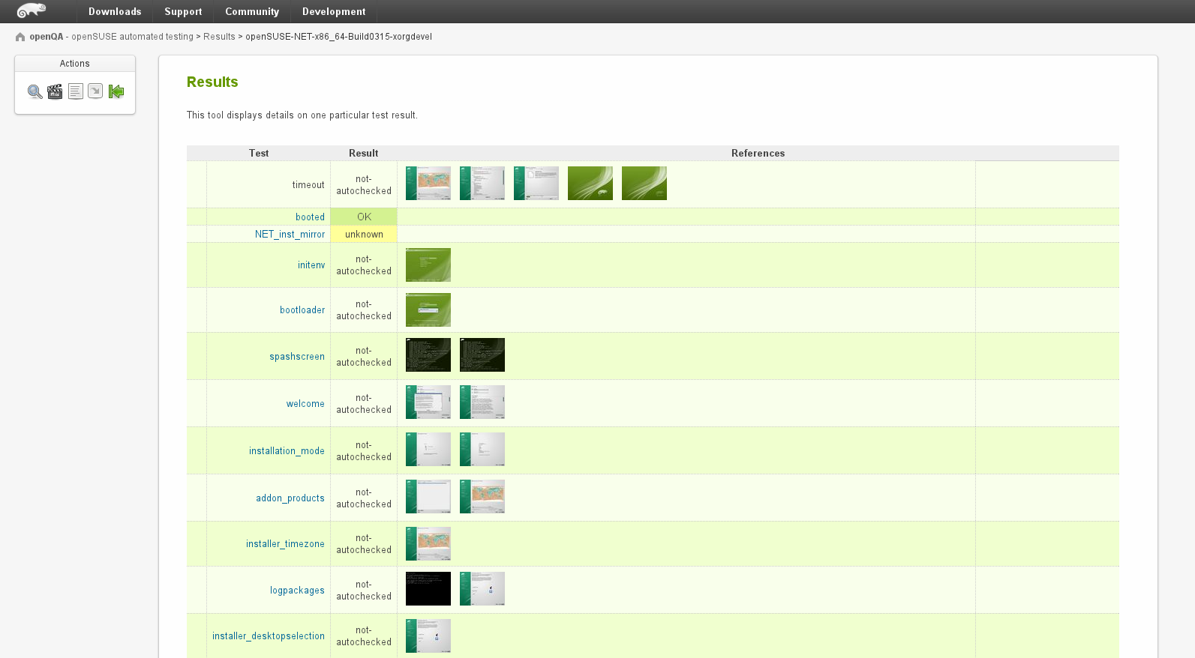
In-dept results of a test from openQA automated testing framework
Notes:
You can see the details of a test, and as you can see you can download and inspect the screenshots.

Slide 34
Rescue CD
12.3 now ships an Xfce based Live CD designed to provide a lightweight and effective environment and powerful applications for recovering lost data, backing up existing data, editing disk partitions and accessing the help channels of openSUSE. Among others, it provides the following applications:
gparted and YaST’s disk partition manager for creating and modifying partitions
Subset of YaST modules to help with system recovery: bootloader manager, network device management
GNU dd_rescue and photorec for recovering lost or corrupt data
grsync, an rsync GUI, useful for backups
lftp: a feature rich ftp client
a lightweight web-browser (Midori), XChat for IRC chat, and a pdf reader to read manuals in that format

Slide 35

openSUSE ARM
Release supported platforms
HCL:BeagleBoard-xM
HCL:PandaBoard
Efika MX
Community supported platforms
Calxeda Highbank
i.MX53 Loco
CuBox
Origen Board
Not yet officially supported but known working platforms
Toshiba AC100
Gumstix Overo (experimental):
Details: http://en.opensuse.org/Portal:ARM

Slide 36

So why openSUSE 12.3 and not other distro?
YaST (Yet another Setup Tool)
installation and configuration tool for openSUSE
it is popular for its easy use and attractive graphical interface
capability to customize your system quickly during and after the installation
can be used to configure your entire system
setup hardware, configure the network, system services and tune your security settings
Details: https://en.opensuse.org/Portal:YaST

Slide 37

Newcomers welcome
Notes:
Which is always looking for new volunteers
people who actually want to make a difference!

Slide 38
Information
Portal: https://en.opensuse.org/Portal:12.3
Features: https://en.opensuse.org/Features
Download: http://software.opensuse.org/123/en
Release notes: https://www.suse.com/releasenotes/x86_64/openSUSE/12.3/
Facebook: https://www.facebook.com/groups/opensuseproject/
Twitter: @openSUSE

Slide 39



Slide 40

Join the gang
Notes:
... come join us and have fun...
Try openSUSE, Tumbleweed, SUSE Studio, TRY OBS, play with us!

Slide 41


Slide 42

Be a Geeko/Kitten
Notes:
Be the Geeko you can be!

Slide 43
Thank you

Slide 44
Image credits
WhiteSmoke: dunno
GreenSmoke: From news.opensuse.org
Invisible Bike: Somewhere from facebook
Tumbleweed: somenametoforget
Newcomers: abcrumly
Join the gang: malingering
Keep Calm+Tomatoes: keep-calm
GeekoKitten: no idea
To be found on Flickr under the above names with a Creative Commons license. Thanks all!

